Slide 1
CONQUER: A Tool for NL-based Query Refinement & Contextualizing Code Search Results
Manuel Roldan-Vega, Greg Mallet, Emily Hill, Jerry Alan Fails

Slide 2
Local Code Search Problem:
Query
There are 3 possible outcomes:
Query is ideal, user wants to quickly hone in on relevant results
Query is close, but is either:
overly general – needs additional words to specialize
Mixed success – needs substituting alternative words
Query is completely inaccurate, user needs completely new words

Slide 3
Our Challenge:
How can we design a single search interface that performs equally well for all these query scenarios?
Ideal query
Close, but not quite
Completely inaccurate
Key insight: focus on the query, rather than the information need
Same query may be used for multiple information needs
Notes:
Example: smart shuffle & shuffle playlist share just one utility method, getRandom
Either feature search might begin with “smart shuffle”
“global random shuffle”
“shuffle queue”

Slide 4
CONQUER Approach
Built on top of prior action/theme search (i.e., phrasal concepts)
Action/theme in signature weighted more than bag of words within method body
For query “add item”…
Better than:
Notes:
Describe a little more
Include history??

Slide 5
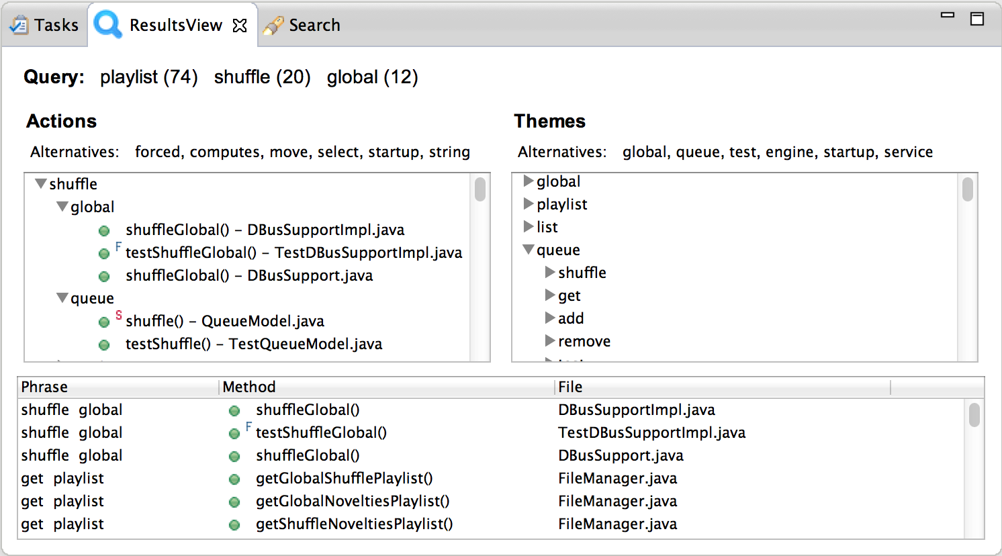
Interface Design
Relative success of query words
Suggested Alternative Query Words
Hierarchy of highest scoring actions & their themes
Traditional result list ranked by score, with phrase for readability
Notes:
Serves ideal queries & non-ideal, gives other ideas of co-occurring terms
Alternatives = highly co-occurring terms
Action sorted by infrequency in rest of program,
Themes sorted by frequently occurring in the result set

Slide 6
Demo
Notes:
To do: strip down CONQ-Eval plug-in

Slide 7
Preliminary User Evaluation
13 developers with industry experience compared CONQUER to Eclipse File Search
Some appreciated the tool:
“the summary trees help faster navigation”
“Query recommendations are *very* helpful”
Others preferred the familiarity of Eclipse:
“I liked seeing the list of class names and the line numbers and the context of where my keywords were found.”
Some disliked Eclipse’s queries difficult to use:
“Touchy results. Make one wrong move and your search results get it.”

Slide 8
Conclusions & Future Work
Each view lends itself to different situations:
When developers know specific names, prefer strict Eclipse-like search
Unfamiliar concept search supported by CONQUER
Future work
How to integrate user-customizability in an intuitive way, without too much screen space
Use synonyms as well as co-occurring terms for alternative query words
Analyze search effectiveness

