Slide 1
Automatic Means of Identifying Evolutionary Events in Software Development
Siim Karus
siim.karus@ut.ee
University of Tartu
Estonia
Notes:
Paper (being published) doi: 10.1109/ICSM.2013.60
Preprint: http://www.cs.ut.ee/~siim04/postdoc/ICSM2013/ICSM2013ERA_Karus.pdf

Slide 2
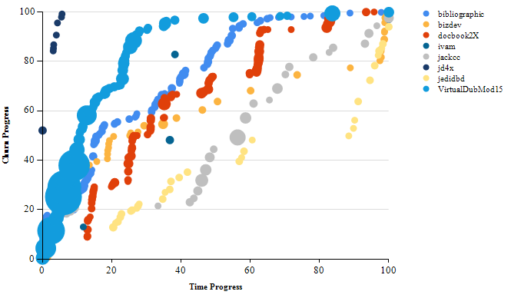
Code Evolution
27 projects
2 time series
14+2 measures
Notes:
Commit number – not organic (different commit strategies, different notations of commits: multi-file commit vs single file commit)

Slide 3
Wavelet Analysis
Length
Scale
Offset
Filter
Coefficients
Offset
Scale
Filter
Length

Slide 4
Discrete Wavelet Transform
Coefficients
Fixed offsets
Scale
Filter
Fixed length

Slide 5
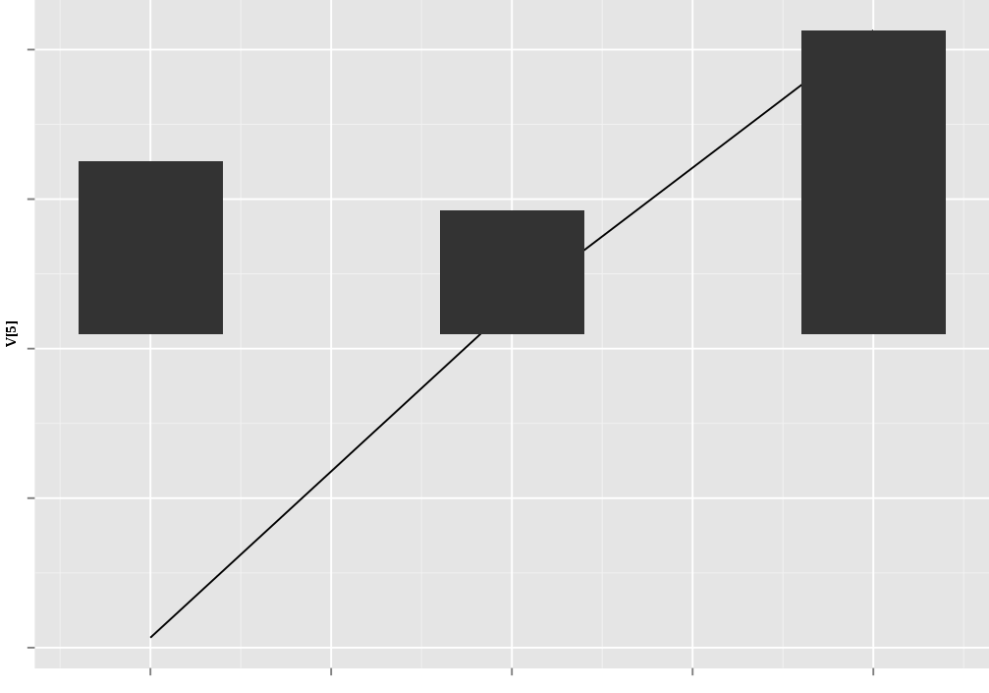
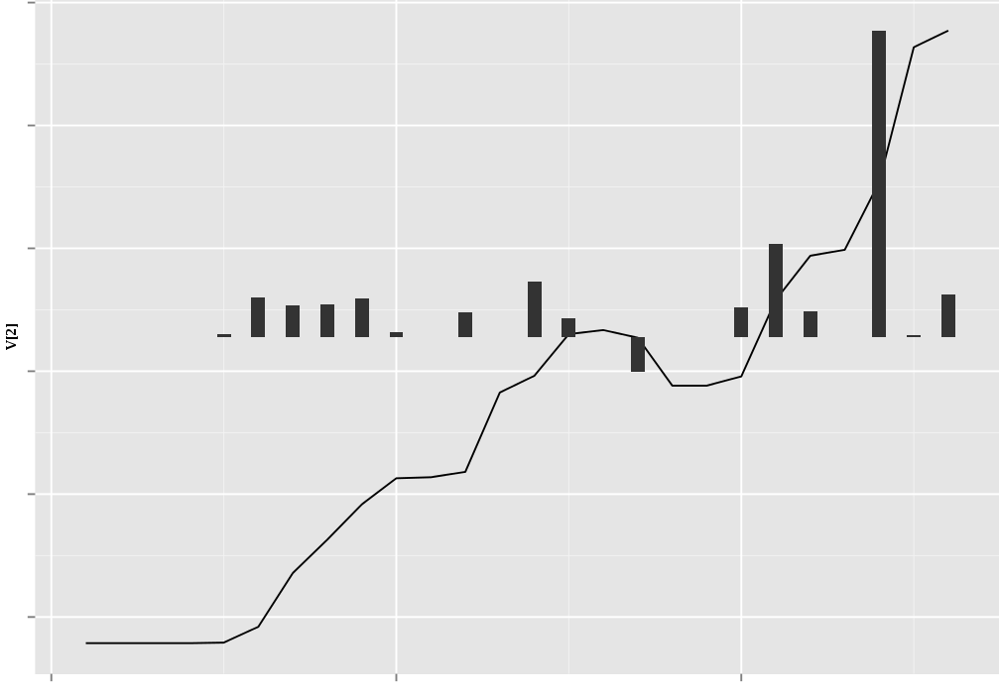
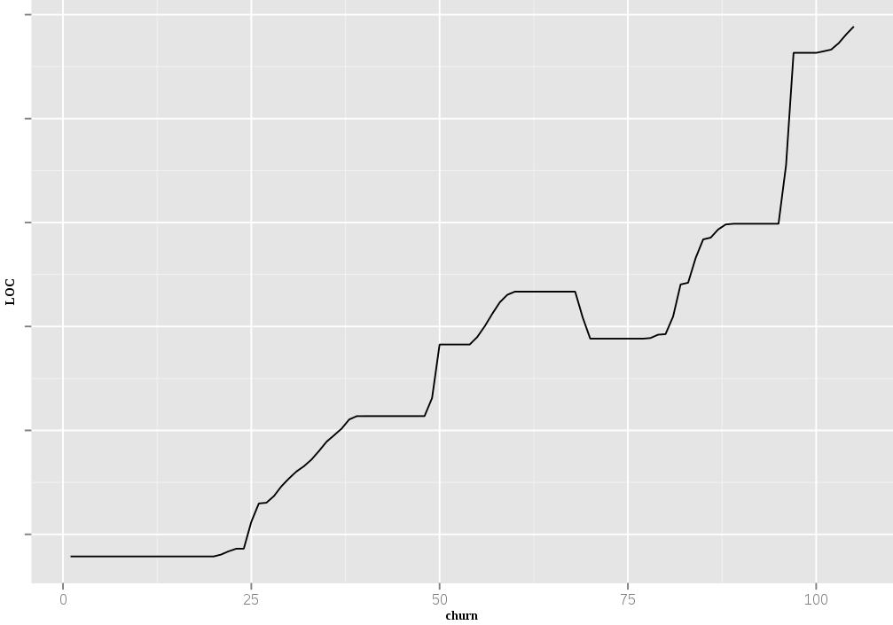
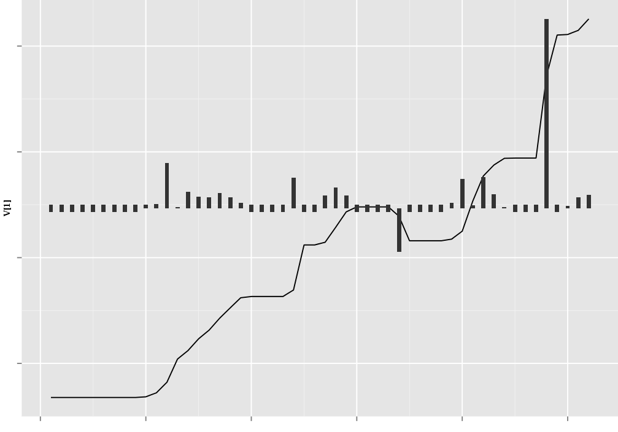
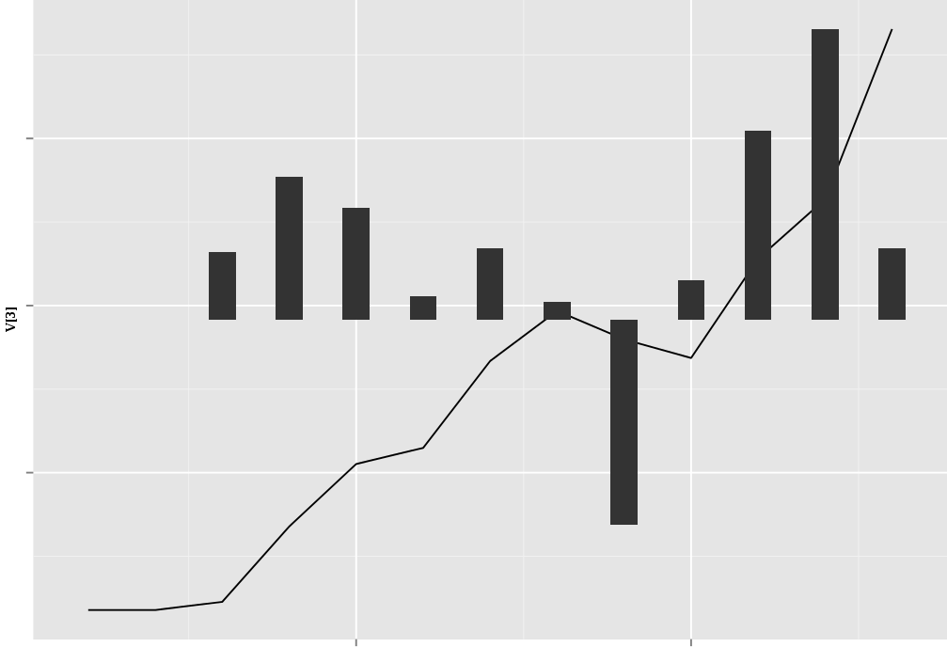
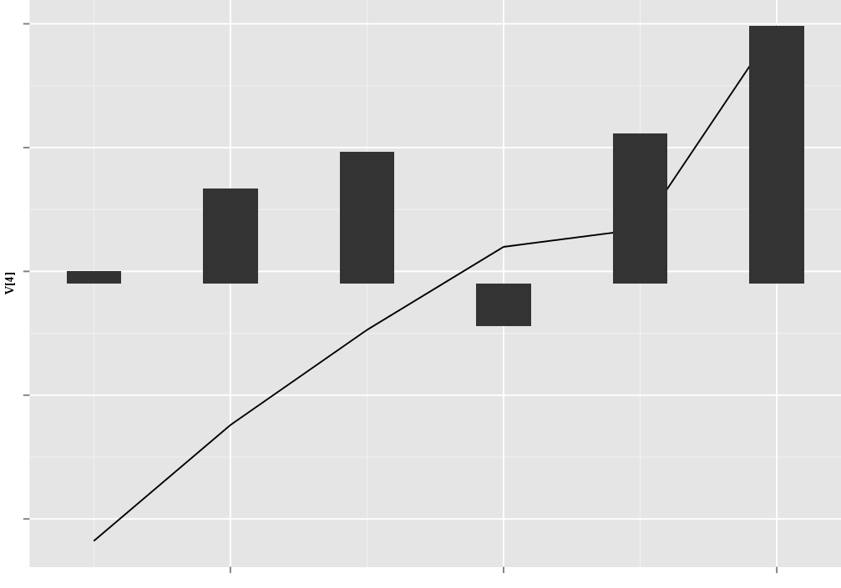
Haar Wavelet
Lossless!
Notes:
Lossless

Slide 6
Results
Wavelet analysis identified 998 patterns common to multiple projects.
This includes warning signs leading to or indicating the impending end of code evolution in the project.
Sudden fluctuations in project attributes are generally signs of problems/abandonment.
Notes:
Step is 2 000 LOC (4 000 LOC on last one)

Slide 7
Results
Definite anomaly
Sudden increases in the absolute value of wavelet coefficients are problem signs.
If absolute value of wavelet coefficients stays high for more than 3 periods, the project is close to abandonment of code development
Possible anomaly
Notes:
Step is 8 000 LOC (16 000 LOC on higher scale)

Slide 8
Conclusions
DWT is efficient for automatic event and anomaly detection in software evolution.
Open source software projects are more similar than different.

Slide 9
Acknowledgement
This work was partially supported by European Regional Development Fund via the Estonian Centre of Excellence in Computer Science.
The author’s presence at ICSM is supported by the Tiger University Program of the Information Technology Foundation for Education.

