Slide 1
A Visualization Tool for Reverse-engineering of Complex Component Applications
Lukas Holy
Co-authors:
Jaroslav Snajberk, Premek Brada, Kamil Jezek
University of West Bohemia in Pilsen,
Czech Republic

Slide 2
Structure of this presentation
2
Introduction of software components and problems in visualization of complex CBSE
Proposed techniques for diagram visualization
Technique implementation and tool demo
Current and future work
Summary of contribution

Slide 3
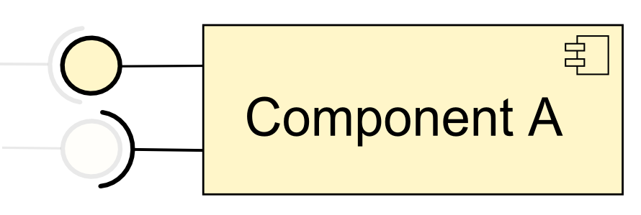
Software components - briefly
3
Clearly defines its interfaces
UML component
diagram
Various component models and frameworks
Currently supported by CoCA-Ex tool are:
  OSGi, EJB, SOFA

Slide 4
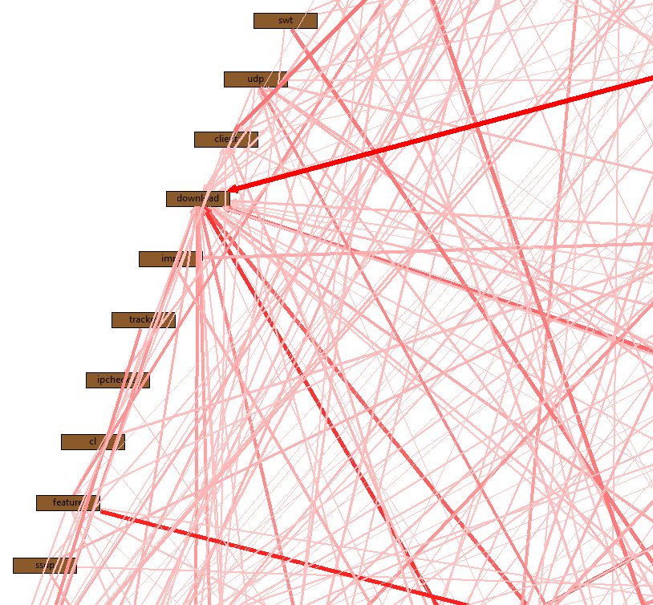
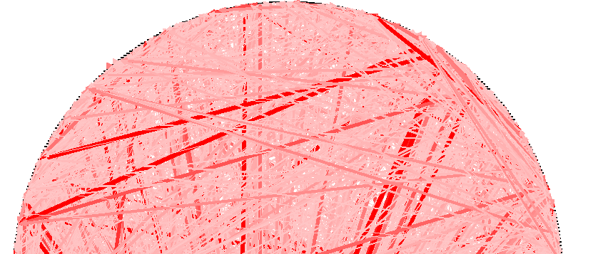
Large component diagrams visualization
4
How to handle the complexity of large UML component diagrams?
Applications can easily consist of thousands nodes
Either overview or detailed view

Slide 5
CoCA-Ex reverse-engineering tool introduction
User uploads components to the server
CoCA-Ex tool shows the component diagram
Users starts working with the diagram and use its features
Users can save and share their diagrams
Technologies used:
  JEE server, JSP, JSON,
  JavaScript, HTML5, SVG, jQuery, qTip
5

Slide 6
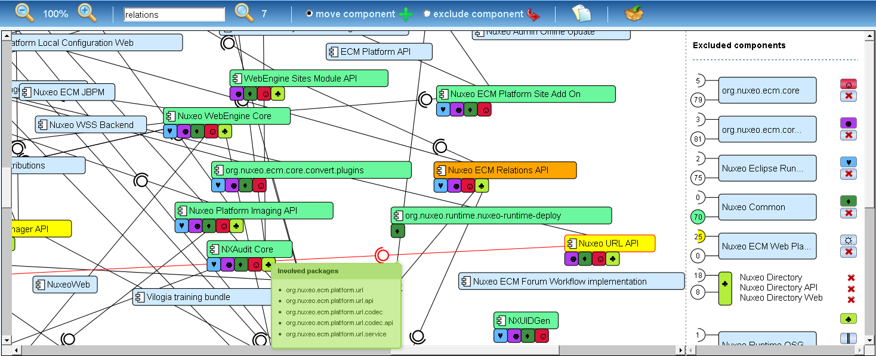
Complex Component Application Explorer (CoCA-Ex) Tool Demo
6

Slide 7
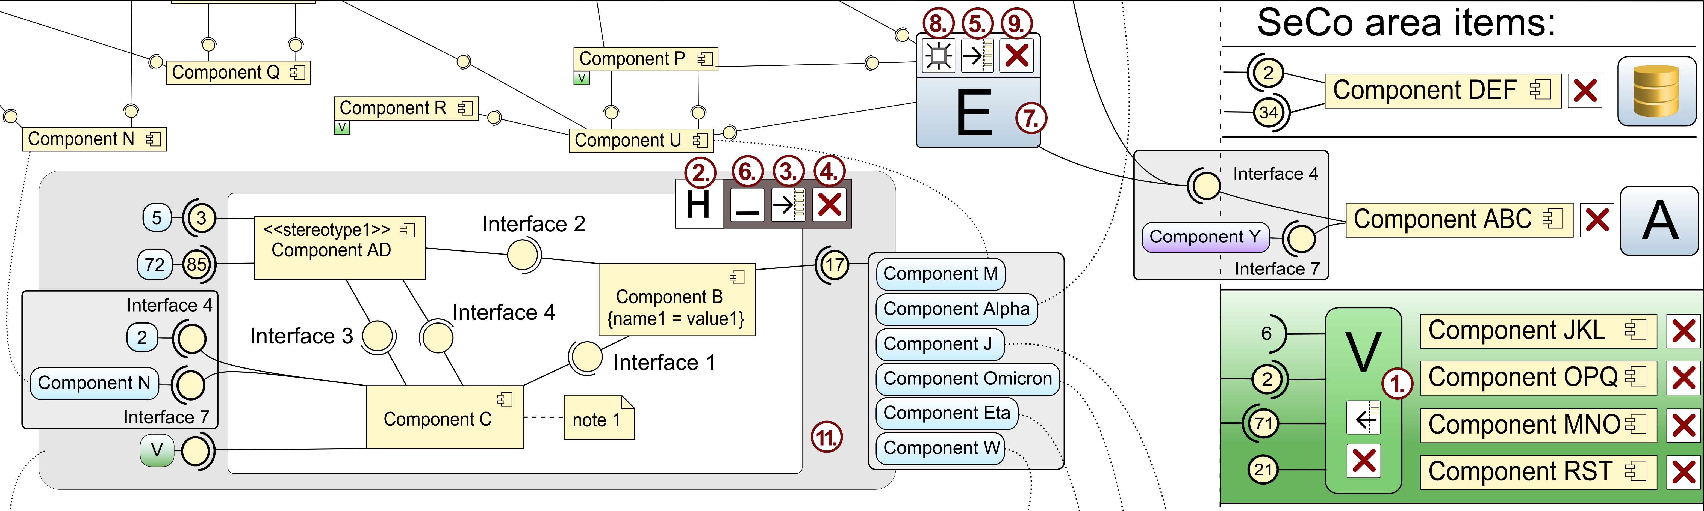
Concepts behind CoCA-Ex tool

Slide 8
Current and Future work
Layout integration
  Default layout after loading the application
Evaluation – Comparative user study
Clustered interfaces exploration
  For large amount of interfaces or components
Clustering integration
  Suggesting clusters for groups after loading the application
8

Slide 9
Summary
Web-based tool, publicly available
  http://147.228.64.46/cocaex
Lines reduction, by removing the selected components from the diagram area to side area (SeCo).
Symbolic delegates instead of lines.
Useful in the reverse engineering process
It helps to create the mental model
9

Slide 10
Q&A
http://147.228.64.46/cocaex
lholy@kiv.zcu.cz
http://www.kiv.zcu.cz/research/groups/dss/projects/large-diagrams-visualization
10

Slide 11
Backup slides
11

Slide 12
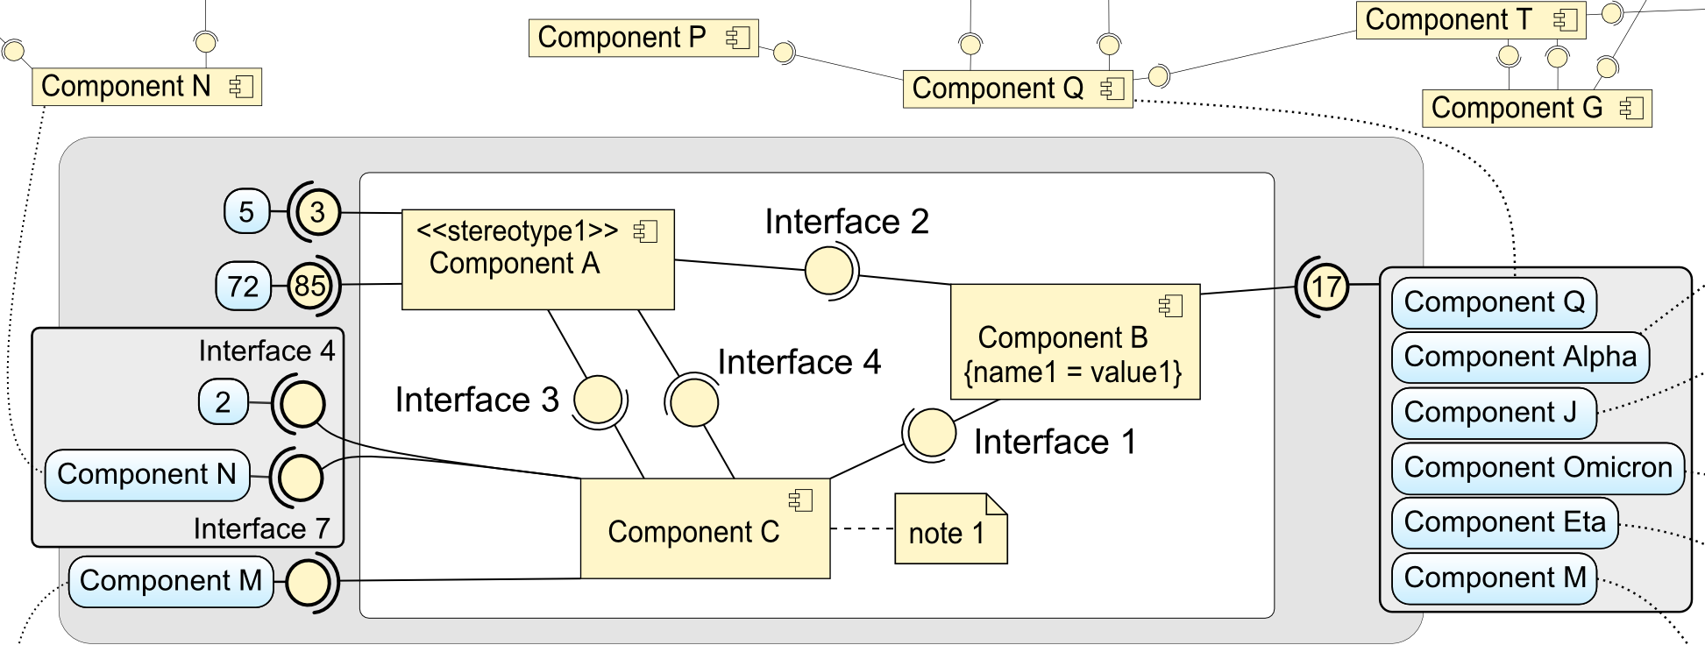
Viewport for component diagrams
Better exploration and understanding
Clustering, proxy elements and detailed view

Slide 13
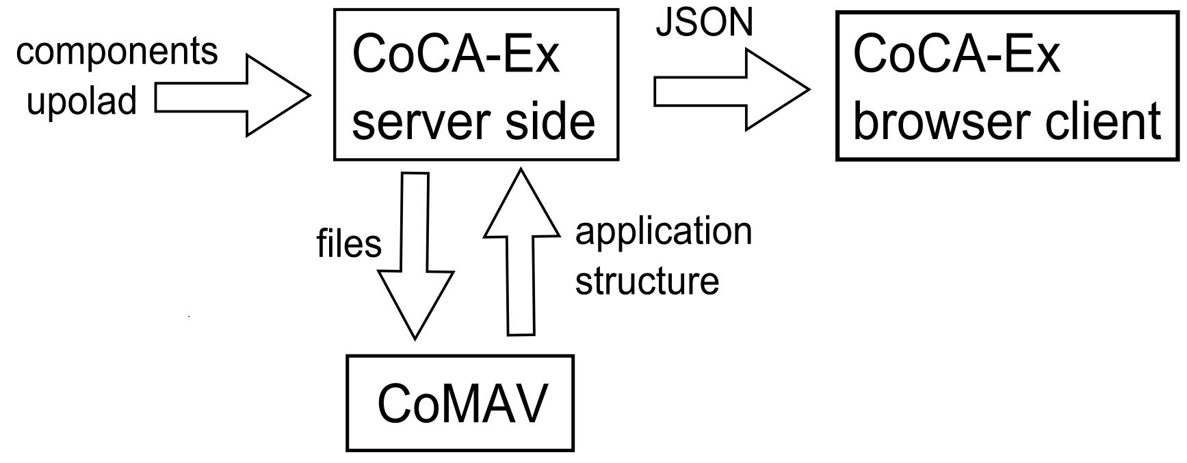
CoCA-Ex tool introduction
JEE server, JSP, JSON
JavaScript, HTML5, SVG, jQuery, …
13

Slide 14
Presented Ideas & Techniques
Visual clutter reduction
  Based on removing highly connected components
  Interface clustering
  Interactive highlighting
    Details on demand
  Groups and clusters identification
14

Slide 15
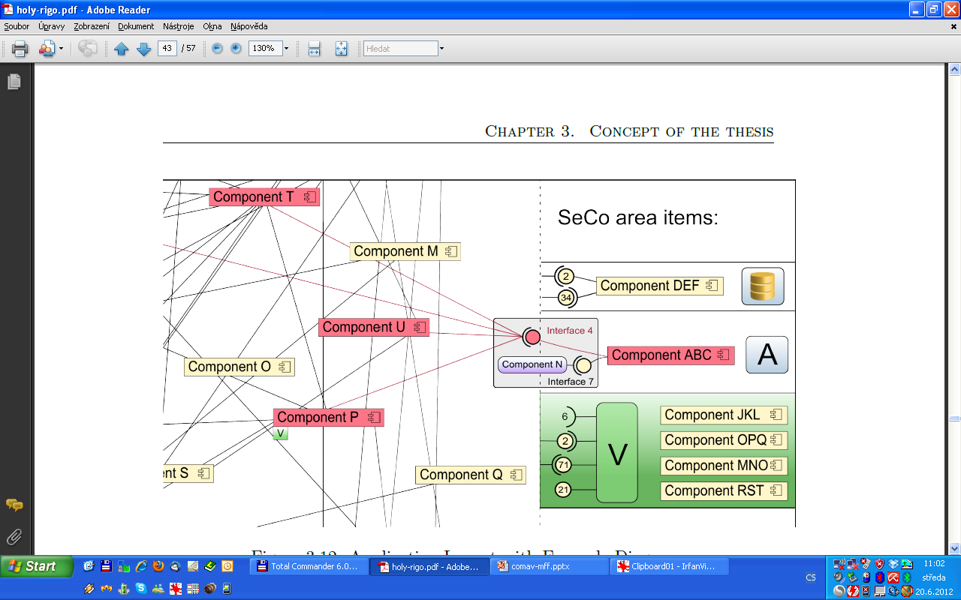
SeCo technique - design overview
15

Slide 16
Preliminary validation - Removing nodes with highest degrees
Nuxeo application visualized by AIVA
All 202 components
Removed 7 components with highest degrees
16

