Slide 1
An Analysis of Machine Learning Algorithms for Condensing Reverse Engineered Class Diagrams
Presenter: Hafeez Osman
Hafeez Osman Michel R.V. Chaudron Peter v.d Putten (hosman@liacs.nl) (chaudron@chalmers.se) (putten@liacs.nl)

Slide 2
Overview
1. Introduction
3. Approach
4. Results
5. Discussion
6. Future Work
7. Conclusion
2. Research Question

Slide 3
Introduction
Who ?
Software Engineer, Software Maintainer, Software Designer
What ?
Simplifying UML Class Diagram: Based on Software Design Metrics using Machine Learning
Why ?
Reverse engineered class diagrams are typically too detailed a representation

Slide 4
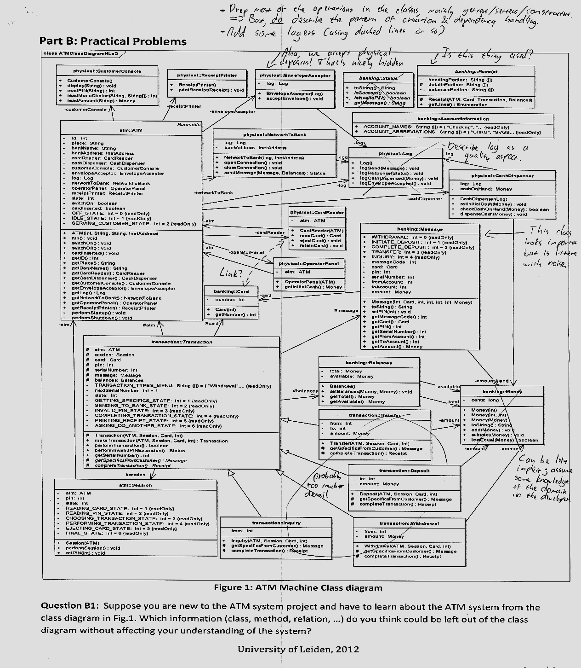

Slide 5
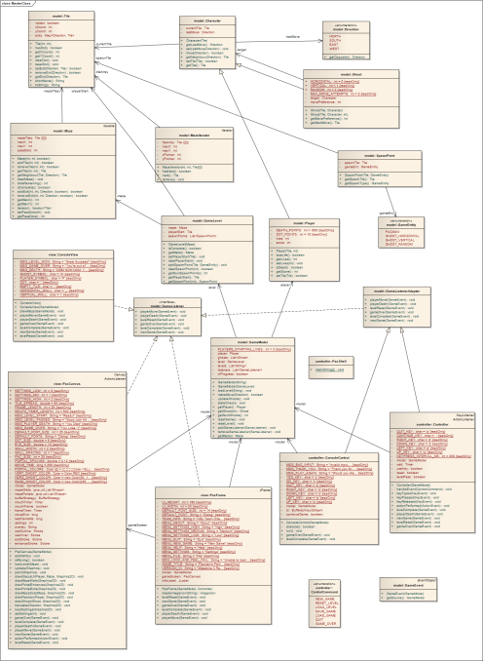
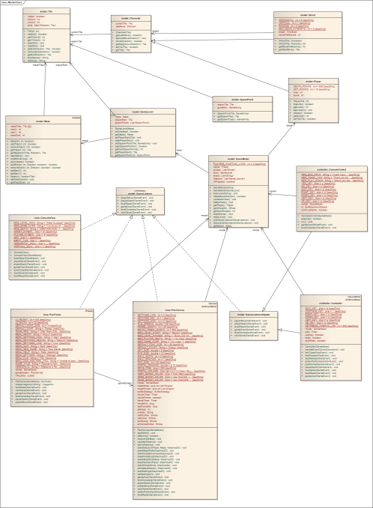
Introduction
Aim: analyze performance of classification algorithms that decide which classes should be included in a class diagram
This paper focusses on using design metrics as predictors (input variables used by the classification algorithm)
Selecting Classes
All Classes Class Diagram
Condensed Class Diagram
Omit
Notes:
Focus on abstracting
& distilling essence of design

Slide 6
Introduction
Explore Structural Properties of Classes
Software design metrics from the following categories :
Size : NumAttr, NumOps, NumPubOps, Getters, Setters
Coupling : Dep_Out, Dep_In, EC_Attr, IC_Attr, EC_Par, IC_Par
Machine Learning Classification Algorithms
Supervised classification algorithms
J48 Decision Tree, Decision Tables, Decision Stumps, Random Forests and Random Trees
k-Nearest Neighbor, Radial Basis Function Networks
Logistic Regression, Naive Bayes,

Slide 7
Research Questions
RQ1: Which individual predictors are influential for
the classification?
For each case study, the predictive power of individual predictors are explored
RQ2: How robust is the classification to the inclusion of particular sets of predictors?
Explore how the performance of the classification algorithm is influenced by partitioning the predictor-variables in different sets.
RQ3: What are suitable algorithms for classifying classes?
The candidate classification algorithms are evaluated w.r.t. how well they perform in classifying the key classes in a class diagram.

Slide 8
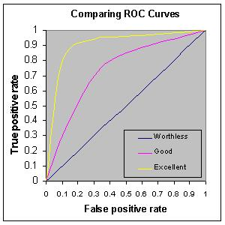
Approach
Evaluation Method
RQ1: Predictors
Univariate Analysis – Information Gain Attribute Evaluator
To measure predictive power of predictors
RQ2, 3: Machine Learning Classification Algorithm
Area Under ROC Curve (AUC)
The AUC shows the ability of the classification algorithms to correctly rank classes as included in the class diagram
or not

Slide 9
Approach
Case Study Characteristics
Project | Total Classes |  | (a)/(b) = %
 | Source code (a) | Design (b)
ArgoUML | 903 | 44 | 4.87
Mars | 840 | 29 | 3.45
JavaClient | 214 | 57 | 26.64
JGAP | 171 | 18 | 10.52
Neuroph 2.3 | 161 | 24 | 14.9
JPMC | 127 | 11 | 8.66
Wro4J | 87 | 11 | 12.64
xUML-Compiler | 84 | 37 | 44.05
Maze | 59 | 28 | 47.45

Slide 10
Approach
Grouping Predictors in Sets
No | Predictor | Predictor Set A | Predictor Set B | Predictor Set C
1 | NumAttr | √ | √ | x
2 | NumOps | √ | √ | x
3 | NumPubOps | √ | x | x
4 | Setters | √ | x | x
5 | Getters | √ | x | x
6 | Dep_out | √ | √ | √
7 | Dep_In | √ | √ | √
8 | EC_Attr | √ | √ | √
9 | IC_Attr | √ | √ | √
10 | EC_Par | √ | √ | √
11 | IC_Par | √ | √ | √
Leave out inheritance
influence
All Metrics
Coupling only

Slide 11
Approach
Reverse engineer the source code to UML design.
Eliminate library classes
Calculate design metrics
Eliminate unused metrics
Merge the information “In Design” with the software design metrics data
Prepare set of predictors
Run all set of predictors with machine learning tool

Slide 12
Result
RQ1 : Predictor Evaluation
** Out of 9 projects

Slide 13
Result
RQ2 : Dataset Evaluation
** Out of 9 projects

Slide 14
Result
RQ3 : Evaluation on Classification Algorithms
** Out of 9 projects

Slide 15
Discussion
Predictor
Three class diagram metrics should be considered as influential predictors:
Export Coupling Parameter(EC Par),
Dependency In (Dep In)
Number of Operation (NumOps)
** Means, a higher value of these metrics for a class indicates that this class can be a candidate for inclusion in the CD.
Classification Algorithm
k-NN(5) and Random Forest are suitable classification algorithms in this study.
Their AUC score is at least 0.64
The classifiers are robust for all projects and predictor sets

Slide 16
Discussion
Threat to Validity
Assumption of ground truth:
Exactly all classes that should be in the forward designs are in the forward design. There is a possibility that :
some of these classes were not the key classes of the system.
there is a possibility that the forward design used is too ‘old’.
Input is dependent on Reverse Engineering tool (MagicDraw)
Cover only 9 open-source projects

Slide 17
Future Work
Alternative predictor variables
use of other type of design metrics ex. (semantics of) the names of classes, methods and attributes.
use source code metrics such as Line of Code (LOC) and Lines of Comments.
Change History of a class
Learning models (classification algorithm)
testing out an ensemble approach (combines classification algorithms)
Semi supervised or interactive approach
Compare this study result with other approaches
Other works that apply different algorithm such as HITS web
mining, network analysis on dependency graphs and PageRank.
5. Validate understandability of abstract Class Diagrams

Slide 18
Conclusion
The most influential predictors
Export Coupling Parameter
Dependency In
Number of Operation
Most suitable Classification Algorithms
Random Forest
k-Nearest Neighbor
Classification algorithms are able to produce a predictor that can be used to rank classes by relative importance.
Based on this class-ranking information, a tool can be developed that provides views of reverse engineered class diagrams at different levels of abstraction.
Developers may generate multiple levels of class diagram abstractions.
Questions…………..

