Slide 1
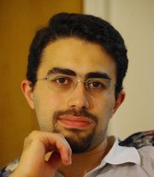
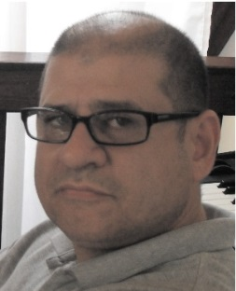
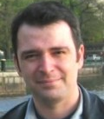
Predicting Developer Initiation from Social Activities
Mohammad Gharehyazie
Daryl Posnett
Vladimir Filkov

Slide 2
Smart
Motivated
Technical
Handsome!
Smart
Motivated
Technical
Less handsome!
But he has the crown
Notes:
Meet me
I am smart, motivated, technical and Handsome!
Meet Daryl
He looks grumpy, but he is wearing a crown (which in our story means he is a developer)
I want to become a developer too.
And Daryl is always looking for new talents.
Easy right?

Slide 3
Notes:
Wrong!
Potential developers can be lost in the sea of other contenders, people who either do not wish to contribute, or just pretend that they want to.
How do participants demonstrate their worth?
How to separate good developers from the crowd?
Who to “trust”?
What is important to developer initiation?

Slide 4
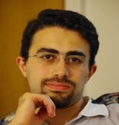
???
Patch submission?
Starting topics?
Joining the discussions?
Notes:
But what is more determinant of my future initiation?
Is it social contribution? Or technical contribution?

Slide 5
Prior work
Quantitative [Zhou et al. 2012] and Qualitative [Von Krogh et al. 2003][Ducheneaut 2005] study of developer initiation, Identifying factors in progression
Different classes of developers have different initiation periods[Qureshi et al. 2011]
Survival models to study “When” one becomes a developer[Bird et al. 2007]

Slide 6
Questions
Q1: To what extent can developer initiation in OSS projects be modeled as a function of patch activities and social communication?
Q2: How well can we predict if a person will become a developer based on information early in their tenure with the project?
Q3: Is it easier or more difficult to become a developer later in the project?

Slide 7
Data gathering

Slide 8
Data gathering (Cont.)
Mailing lists
Forum like
Broadcast messages
Gives us an “Email Social Network”, list of people involved in the project, and potential future developers.
Also gives us lists of topics and those who started them.

Slide 9
Data gathering (Cont.)
Issue tracking systems
Forum like
Each topic is associated to a specific bug
Along with the mailing lists, gives us crowd contribution to the project.
Requires mining several sources and merging separate datasets. (Hard!)

Slide 10
Data gathering (Cont.)
Repository History
Date of changes
ID of developers
Files that have been changed
Gives us list of developers and the date of their first commit.

Slide 11
Methodology (Input Data)
Number of messages one sends and receives (Social Activity)
Number of threads one starts (Social Initiative)
Number of patches one submits (Technical Contribution)
Age of the project when one joins that project (Control variable)

Slide 12
Methodology (Cont.)
Target: Whether one becomes a developer
Logistic regression
= f( , , , )
Model evaluation from two perspectives:
Model’s statistical relevance: p-value
Model’s predictive power: Using stratified sampling and AUROC
250 times
2/3 training
1/3 testing

Slide 13
Q1 Results
Can developer initiation in OSS projects be modeled as a function of patch activities and/or social communication?
Notes:
3 months observation per individual
1 model per project

Slide 14
Q1 Results (Predictive power)

Slide 15
Q1 Results (Cont.)
Developer initiation can be modeled using social activity alone, performing no worse than models which also incorporate patch submission.
The basic model of social activity only uses “Number of Messages”.
Adding “Number of Threads” improved prediction results in 2 of the projects, hinting this might be a matter of “project culture”.

Slide 16
Q2 Results
How well can we predict if a person will become a developer based on information early in their tenure with the project?
Notes:
Model only using messages

Slide 17
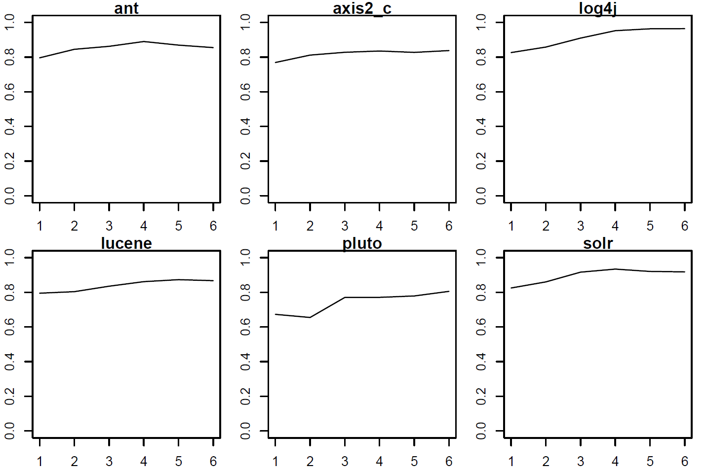
Q2 Results (Cont.)

Slide 18
Q2 Results (Cont.)
Developer initiation can be modeled with as little as one month’s information about the social activity of individuals.
Using three months yields stronger and more stable result.

Slide 19
Q3 Results
Q3: Is it easier or more difficult to become a developer later in the project?
 | Ant | Axis2_c | Log4j | Lucene | Pluto | Solr
(Intercept) | -5.76 | -4.93 | -7.04 | -5.42 | -3.8 | -6.33
Number of messages | 1.24 | 0.82 | 1.78 | 0.99 | 0.88 | 1.07
IsSecond | -0.57 | -1.84 | -0.99 | -2.67 | -2.01 | -1.29

Slide 20
Q3 Results (Cont.)
Given the same amount of social (and/or technical) contribution, it is less probable to become a developer later in a project’s life.

Slide 21
Conclusions
Social activity is more determinant of someone’s future in an OSS project than Code contribution.
Predictions can be made fairly early in a person’s tenure.
As projects mature, becoming a developer is less probable.
Warning: correlation does not imply causality!

Slide 22
Acknowledgements
Bogdan Vasilescu
Air Force Ofﬁce of Scientiﬁc Research
award FA955-11-1-0246
Davis Eclectic Computational Analytics Lab (DECAL) at UC Davis

Slide 23
Thank you

