Slide 1
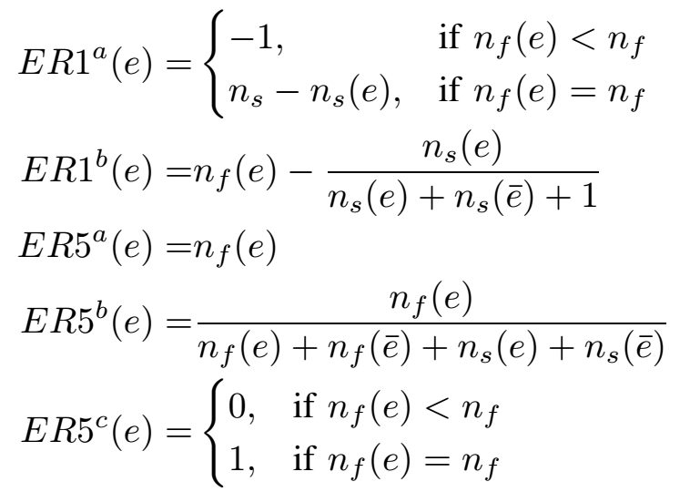
Theory and Practice, Do They Match?
A Case With Spectrum-Based Fault Localization
Tien-Duy B. Le, Ferdian Thung, and David Lo
{btdle.2012,ferdiant.2013,davidlo}@smu.edu.sg
Motivation
Dataset
Theoretically Best SBFL Formula by Xie et. al.
Application | #Faults
NanoXML | 29
Siemens Test Suite (7 programs) | 119
Space | 35
XMLSec | 16
Total | 199
Real Life Programs
?
vs.
Popular SBFL Formula
Average test coverage in our dataset is 84.97%.
Result
Spectrum Based Fault
Localization (SBFL)
Effectiveness Measure
Definition
a technique to localize failures to certain parts of a program by utilizing program spectra collected from software testing and the results of the tests (pass or fail)
Effectiveness of The SBFL Formulas
SBFL Formula | Average EXAM Score | Standard Deviation
Tarantula | 23.37% | 23.44%
Ochiai | 21.02% | 21.96%
ER1ª | 33.34% | 35.22%
ER1^{b} | 21.09% | 19.48%
ER5ª | 43.04% | 19.63%
ER5^{b} | 43.04% | 19.63%
ER5^{c} | 54.95% | 26.83%
Statistics for SBFL
Notion | Description
 | Number of successful test cases that execute e
 | Number of failing test cases that execute e
 | Number of successful test cases that do not execute e
 | Number of failing test cases that do not execute e
Popular SBFL Formula
Wilcoxon signed rank test (significance rate of 0.05)
Ochiai is statistically better than ER5ª, ER5^{b}, ER5^{c}
Conclusion
Theoretically best SBFL formulas are proven the best in theory, but in practice:
They do not work as well:
Ochiai outperforms all of them.
Tarantula outperforms four of them.
The 100% test coverage assumption does not hold.
Theoretically Best SBFL Formula
Reference
X. Xie, T. Chen, F.-C. Kuo, and B. Xu, “A theoretical analysis of the risk evaluation formulas for spectrum-based fault localization,” TOSEM (to appear), 2013.
Lucia, D. Lo, L. Jiang, and A. Budi, “Comprehensive evaluation of association measures for fault localization,” in ICSM, 2010.
Notable assumption: 100% test coverage

