Slide 1
Mining Software Repositories for Accurate Authorship
Xiaozhu Meng, Barton P. Miller, William R. Williams, and Andrew R. Bernat

Slide 2
Line-level authorship information is useful for:
Analyzing software quality
Performing software forensics
Improving software maintenance
Code
2

Slide 3
Limitation of the current methods
Current tools:
git-blame, svn-annotate, and cvs-annotate
They only report the last change
printk("%s%s[%d]: segfault at %lx ip %p sp %p error %lx", task_pid_nr(tsk) > 1 ? KERN_INFO : KERN_EMERG, tsk->comm, task_pid_nr(tsk), address, (void *)regs->ip, (void *)regs->sp, error_code);
Alice
Bob
Miss earlier changes
printk("%s%s[%d]: segfault at %lx ip %p sp %p error %lx", task_pid_nr(tsk) > 1 ? KERN_INFO : KERN_EMERG, tsk->comm, task_pid_nr(tsk), address, (void *)regs->ip, (void *)regs->sp, error_code);
Jim
Alice
Bob

Slide 4
Accurate line-level authorship
Repository graph
A graph abstraction of a code repository
Structural authorship
A sub-graph recording the development history of a line of code
Weighted authorship
Contribution weights for each author

Slide 5
Steps to extract accurate line-level authorship
Code repository
Weighted authorship:
(Alice: 50%, Bob: 30%, Jim: 20%)
Repository graph:
Structural authorship:
for a line of code

Slide 6
Repository graph
Alice
Bob
Jim
Nodes are revisions:
Snapshots of different stages of the project
δ_{3,4}
s₃
s₄
δ_{2,3}
δ_{4,7}
δ_{0,1}
δ_{1,2}
δ_{2,5}
δ_{5,6}
δ_{6,7}
δ_{7,10}
s₀
s₁
s₂
s₅
s₆
s₇
s₁₀
Edges represent development dependencies:
branching and merging create multiple paths
δ_{5,8}
δ_{9,10}
δ_{8,9}
s₈
s₉
Edges are annotated with code changes:
Added, deleted, and changed lines
Code changes can be composed along a path

Slide 7
Structural authorship
A sub-graph records the development history of a line of code
Alice
Bob
Jim
δ_{3,4}
s₃
s₄
δ_{2,3}
δ_{4,7}
δ_{1,2}
δ_{2,7}= δ_{6,7} ○ δ_{5,6} ○ δ_{2,5}
δ_{0,1}
δ_{2,5}
δ_{5,6}
δ_{6,7}
δ_{7,10}
s₀
s₁
s₂
s₅
s₆
s₇
s₁₀
δ_{5,8}
δ_{9,10}
δ_{2,9}= δ_{8,9} ○ δ_{5,8} ○ δ_{2,5}
δ_{8,9}
s₈
s₉

Slide 8
Weighted authorship
Contribution weights for each author
Jim
force_sig_info_fault(si_code);
Bob
force_sig_info_fault(si_code, address | 0xff, tsk);
Alice
force_sig_info_fault(si_code, address, tsk, 0);
force_sig_info_fault(si_code, address, tsk, 0);
force_sig_info_fault(si_code, address, tsk, 0);
force_sig_info_fault(si_code, address, tsk, 0);
force_sig_info_fault(si_code, address, tsk, 0);
(Alice: 4.5%, Bob: 25%, Jim: 70.5%)

Slide 9
Our new git-author
Implement repository graph, structural authorship, and weighted authorship
Use a syntax similar to that of git-blame

Slide 10
Evaluation
Multi-author study
Source code bug prediction study
or

Slide 11
Multi-author study
Investigate the percentage of multi-author lines
git-blame loses information on these lines
git-author identifies 6% ~ 9% of total lines as multi-author lines
Repository | Multiple Authors | Number of lines
Dyninst | 40K (9.12%) | 434K
GCC | 217K (6.27%) | 3454K
Gimp | 78K (8.12%) | 955K
Httpd | 20K (8.15%) | 247K
Linux | 1072K (7.22%) | 14857K

Slide 12
Source code bug prediction
A machine learning based technique to
Learn the characteristics of previous bugs
Predict where current bugs are
Improve software testing
Prioritize testing
Reduce testing effort

Slide 13
Bug prediction study
Investigate whether accurate line-level authorship improves bug prediction
Module-level
Coarser
A module or a file still contains a lot of code!
File-level
Finer
Line-level
Locate suspicious lines

Slide 14
Approach comparison
A bug prediction model uses a machine learning technique to learn bug predictors and predict where the bugs are
Model components | File-level model^{[1]} | Line-level model
Input | a source file | a line of code
Output | the bug density* of the file | the probability that the line is buggy
Bug predictors | code churn | weighted authorship
 | age | number of authors
 | bug fixes | number of commits
Machine learning technique | linear regression | linear SVM
VS
* Bug density of a source file is the average number of bugs per line
[1] Y. Kamei, et al. Revisiting common bug prediction ﬁndings using effort-aware models. 2010.

Slide 15
Experiment setup
Match if the bug is present in the release
Bug #1
Release 1
Bug report database
Code repository
Bug #2
Release 2
Bug #3
Release 3
Apache HTTP Server Project
We selected seven releases that had a large number of reported bugs
For each release, we trained on that release and predicted on the next release

Slide 16
Performance comparison
The closer a model gets to the top-left corner, the better the model is
Point (x,y) means that by testing x% of total lines of code, we can find y% of total bugs

Slide 17
Results: Apache 2.2.10 predicting 2.3.0

Slide 18
Future work: binary code authorship
Software forensics:
Use git-author for ground truth
Malware binaries
Learning-based coding style attribution

Slide 19
Conclusions
Structural authorship and weighted authorship overcome a weakness of the current methods
Git-author extracts more information than git-blame on 6% to 9% of total lines
This information improves source code bug prediction

Slide 20
Questions?
Git-author is available at:
https://github.com/mxz297/Git-author

Slide 21
Numerical metrics
Area under the curve (AUC) is a numerical summary of the performance of a model
The difference of AUC between two models represents the testing effort saved by the better model

Slide 22
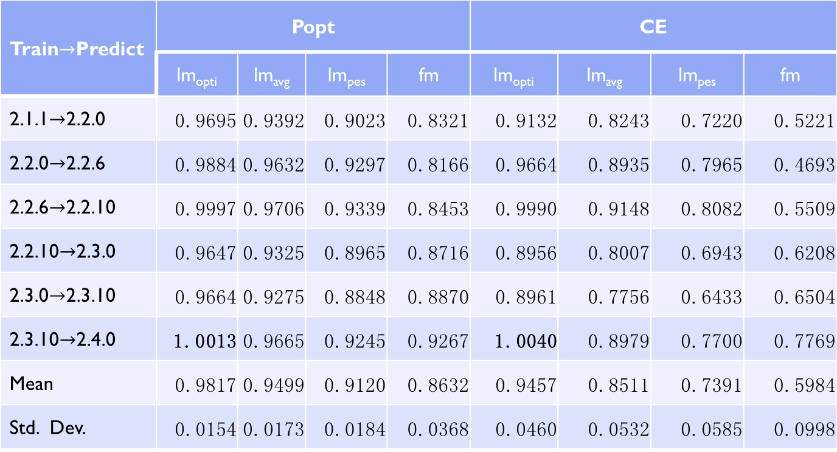
Bug Results
Train$→$Predict | Popt |  |  |  | CE
 | lm_{opti} | lm_{avg} | lm_{pes} | fm | lm_{opti} | lm_{avg} | lm_{pes} | fm
2.1.1$→$2.2.0 | 0.9695 | 0.9392 | 0.9023 | 0.8321 | 0.9132 | 0.8243 | 0.7220 | 0.5221
2.2.0$→$2.2.6 | 0.9884 | 0.9632 | 0.9297 | 0.8166 | 0.9664 | 0.8935 | 0.7965 | 0.4693
2.2.6$→$2.2.10 | 0.9997 | 0.9706 | 0.9339 | 0.8453 | 0.9990 | 0.9148 | 0.8082 | 0.5509
2.2.10$→$2.3.0 | 0.9647 | 0.9325 | 0.8965 | 0.8716 | 0.8956 | 0.8007 | 0.6943 | 0.6208
2.3.0$→$2.3.10 | 0.9664 | 0.9275 | 0.8848 | 0.8870 | 0.8961 | 0.7756 | 0.6433 | 0.6504
2.3.10$→$2.4.0 | 1.0013 | 0.9665 | 0.9245 | 0.9267 | 1.0040 | 0.8979 | 0.7700 | 0.7769
Mean | 0.9817 | 0.9499 | 0.9120 | 0.8632 | 0.9457 | 0.8511 | 0.7391 | 0.5984
Std. Dev. | 0.0154 | 0.0173 | 0.0184 | 0.0368 | 0.0460 | 0.0532 | 0.0585 | 0.0998

Slide 23
Line count results

Slide 24
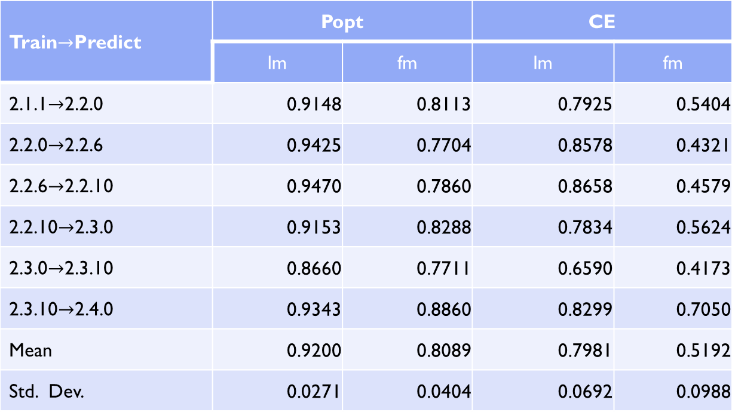
Line Count Results
Train$→$Predict | Popt |  | CE
 | lm | fm | lm | fm
2.1.1$→$2.2.0 | 0.9148 | 0.8113 | 0.7925 | 0.5404
2.2.0$→$2.2.6 | 0.9425 | 0.7704 | 0.8578 | 0.4321
2.2.6$→$2.2.10 | 0.9470 | 0.7860 | 0.8658 | 0.4579
2.2.10$→$2.3.0 | 0.9153 | 0.8288 | 0.7834 | 0.5624
2.3.0$→$2.3.10 | 0.8660 | 0.7711 | 0.6590 | 0.4173
2.3.10$→$2.4.0 | 0.9343 | 0.8860 | 0.8299 | 0.7050
Mean | 0.9200 | 0.8089 | 0.7981 | 0.5192
Std. Dev. | 0.0271 | 0.0404 | 0.0692 | 0.0988

